Slide 1
Sales dataset analysis advanced excel project
Anuriya Raveendran
10/2/2025
DA DS – aug batch

Slide 2
Project objective :
The primary objective of this analysis is to evaluate the sales performance and profitability of the Superstore's operations across different dimensions such as product categories, customer segments, regions, and time periods. This analysis aims to identify key drivers of revenue, uncover trends, and provide actionable insights for improving profitability and operational efficiency and helps to make a effective dashboard insights .
Goals :
o Analyze sales trends over time.
o Identify high-performing products and sales channels.
o Determine the impact of returns and discounts.
o Create a dynamic dashboard with key metrics.

Slide 3
Data description and cleaning :
Dataset –There are 9994 rows and 20 columns , and some of the additional calculated columns.
Data cleaning –
Removing duplicates
Sorting and filtering
Data formatting

Slide 4
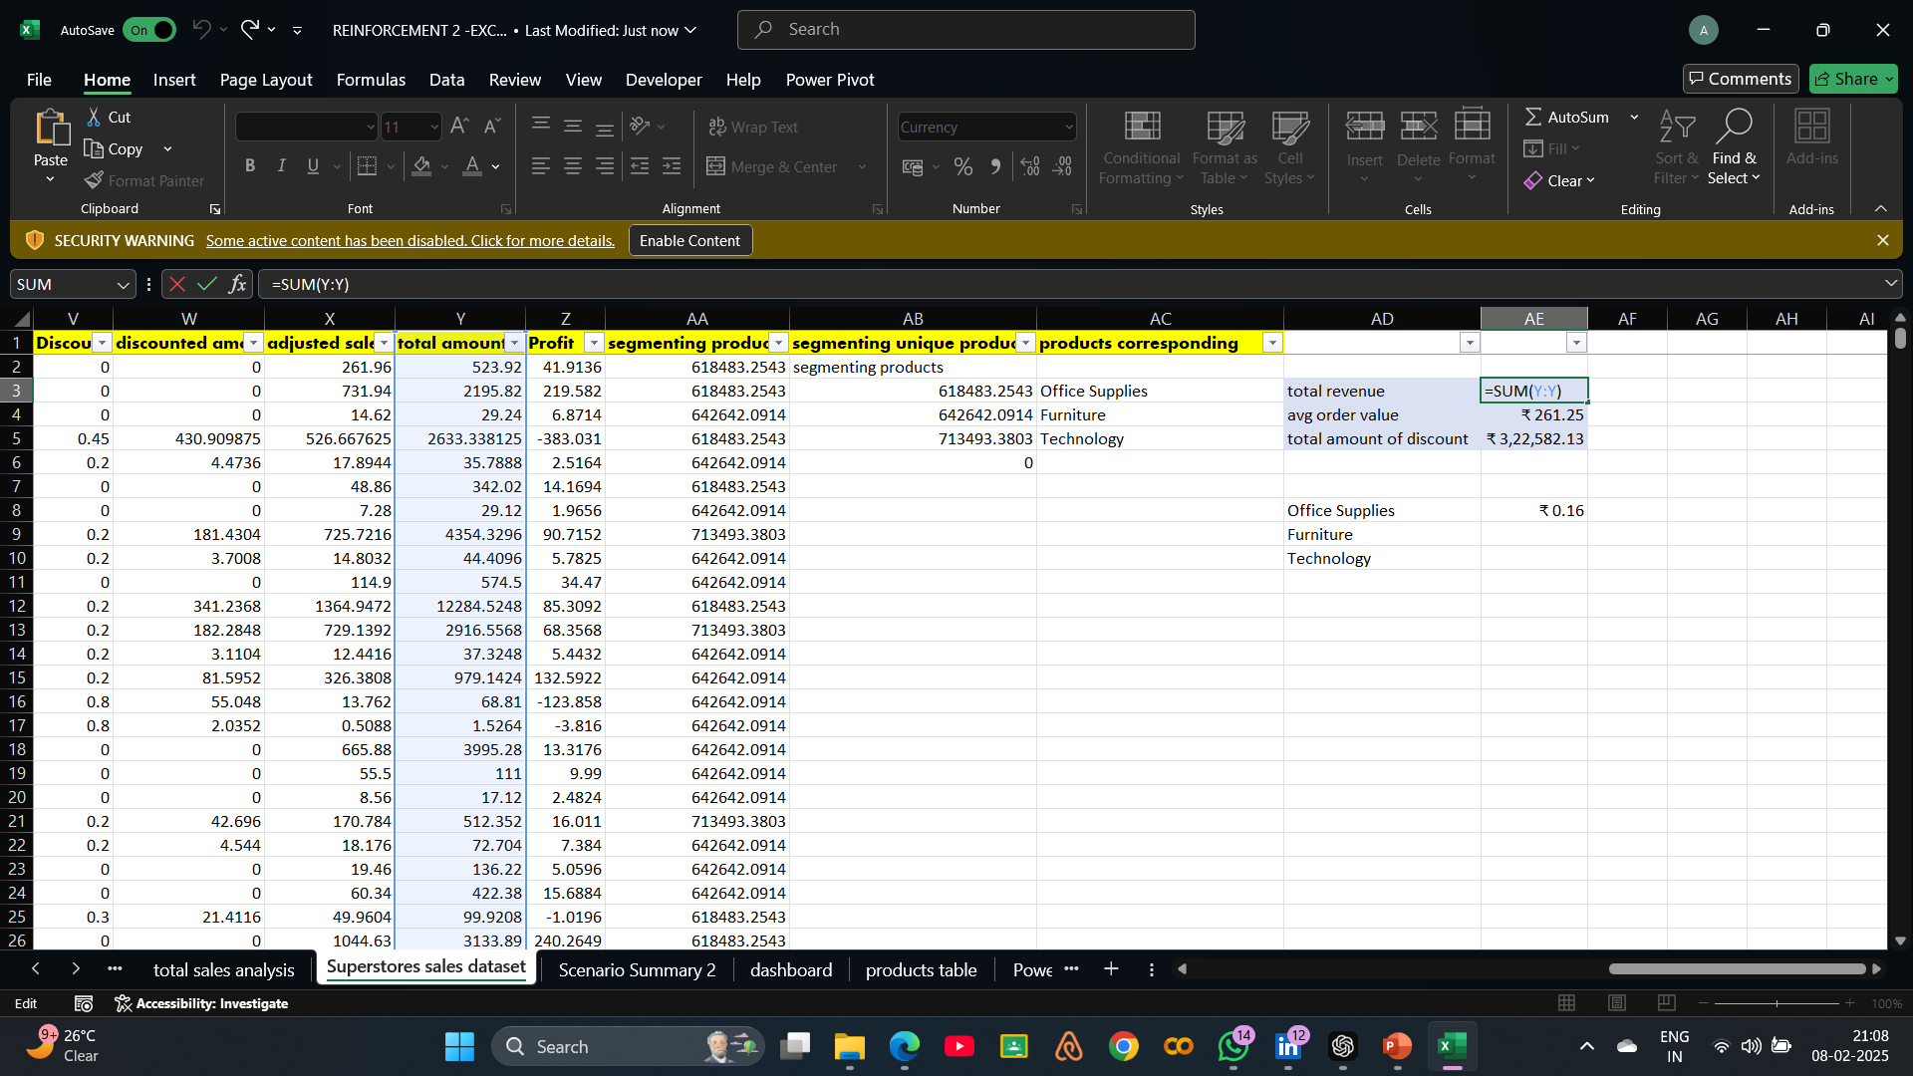
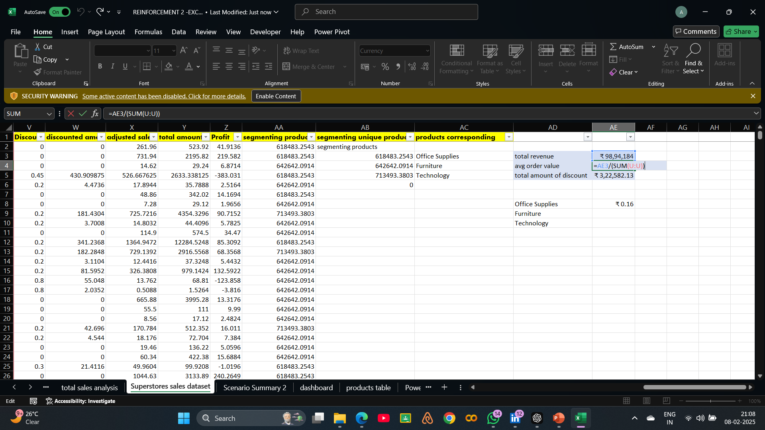
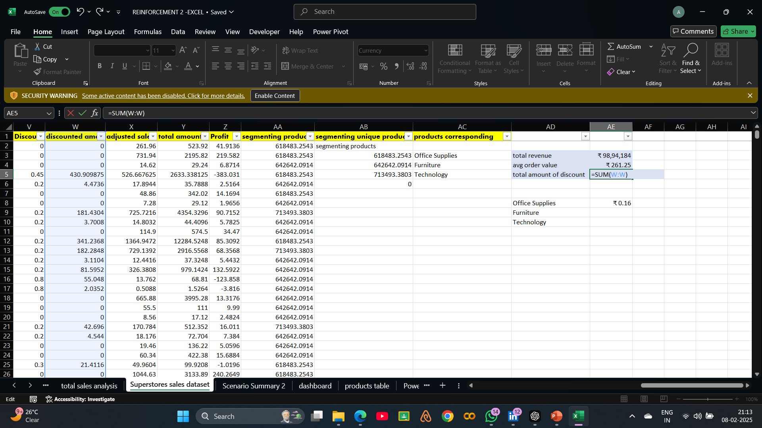
Key metrics calculations and data analysis
Total sales /total amount (Adjusted)
Average sales per order
Total revenue
Total amount of discount
Segmenting product

Slide 5
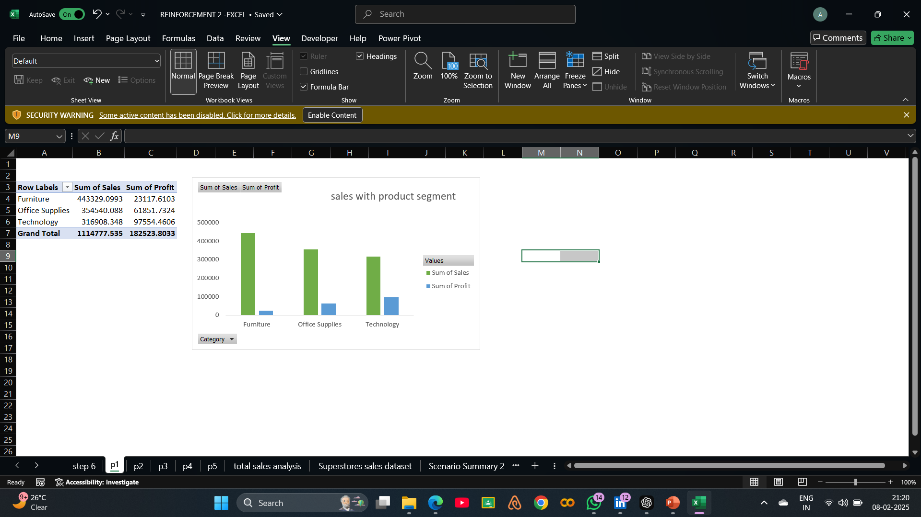
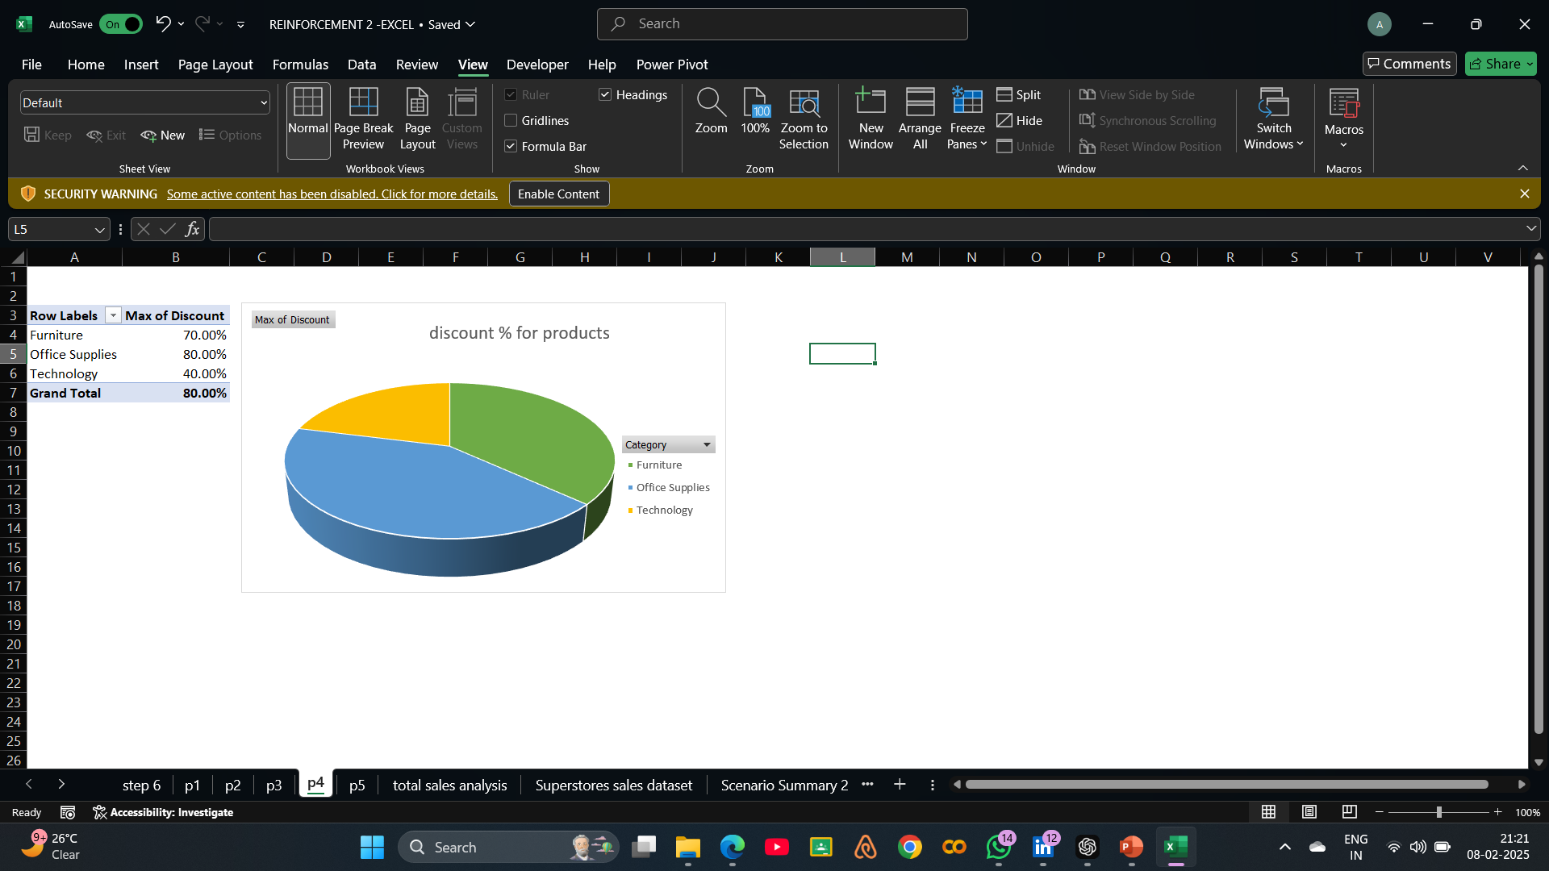
Pivot tables and pivot charts

Slide 6
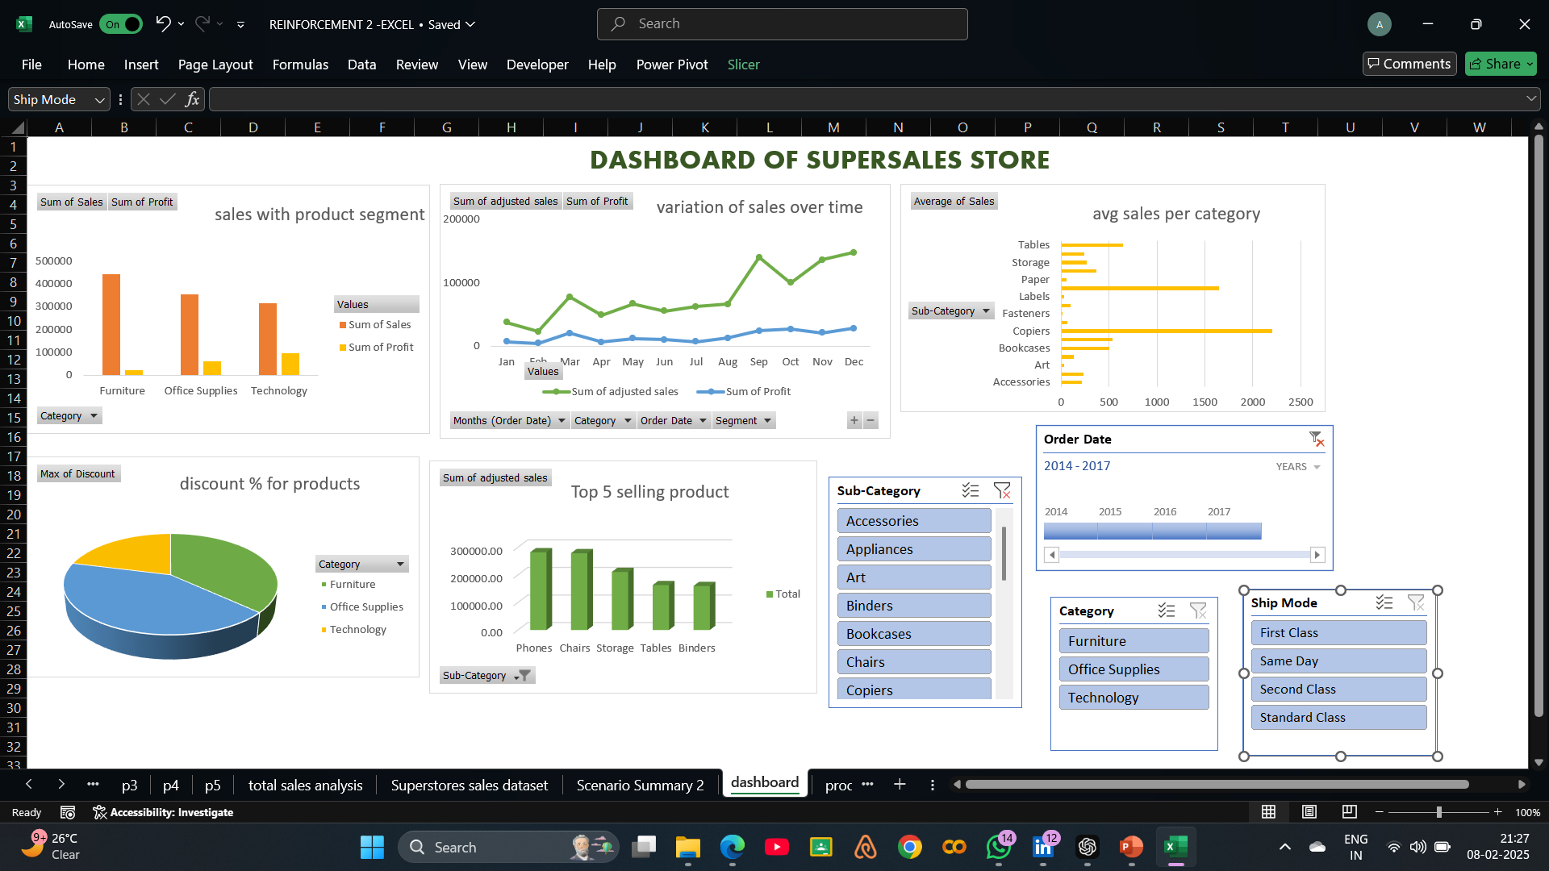
Dashboard overview

Slide 7
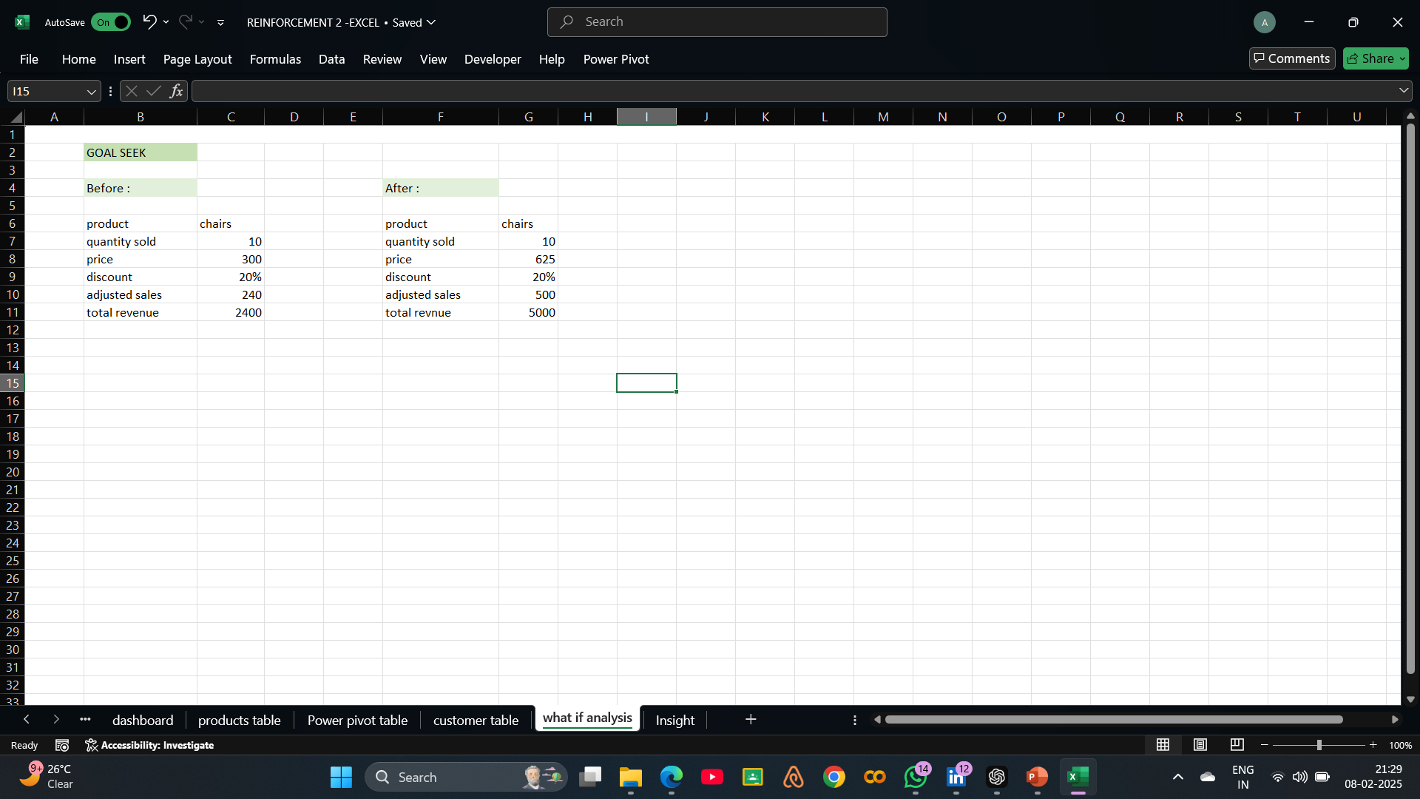
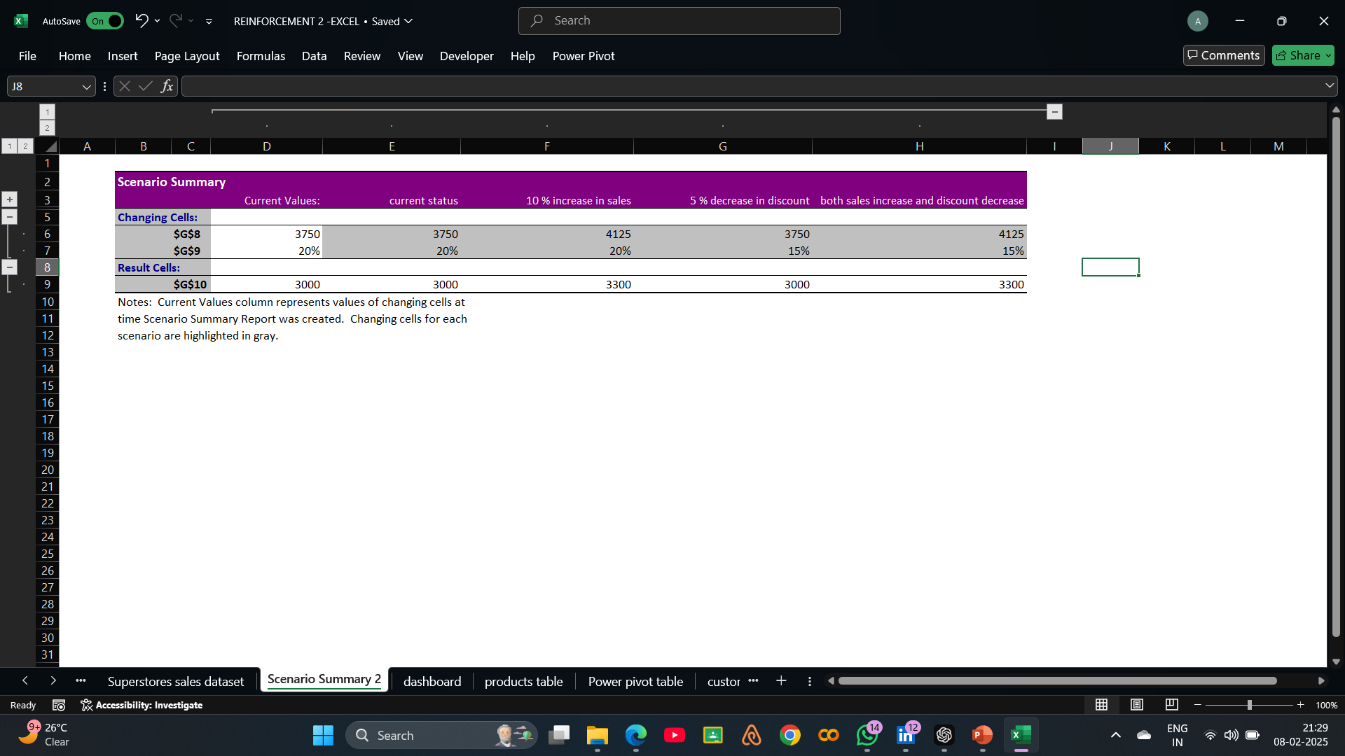
What if analysis

Slide 8
Insights
Top Categories by Sales:
Office Supplies: ₹6,18,483.25
Furniture: ₹6,42,642.09
Technology: ₹7,13,493.38
Profitability:
Each category contributes variably to overall profit, with Technology showing potential for maximization through refined strategies.
Discount Insights:
Discounts are proportionally distributed, with potential overuse in certain segments.
Top-Selling Products:
Sub-categories under Technology and Office Supplies are contributing significantly to revenue.
Performance Metrics:
The segmentation technique has helped clearly identify revenue and profit contributions, simplifying decision-making for targeted marketing or inventory management.

Slide 9
Conclusions
The analysis highlights that the West region is the top-performing market, driven by strong sales across all product categories, while the South region lags behind in total sales and profitability. Technology products generate the highest revenue, while Office Supplies and Furniture offer opportunities for improved margins
Recommendations
Focus on expanding marketing and tailored product offerings in the South region. Enhance profitability by optimizing discount strategies. Leverage the West’s high sales with premium product introductions and improve supply chain efficiency across all regions.

Slide 10
Thankyou !

